Slide 1
MYCIN

Slide 2
Table of Contents
What’s the Problem?
Why an Expert System?
What’s MYCIN?
Major Features
Problem Solving Approach
Other MYCINs
Summary

Slide 3
What’s the Problem?
Diagnosing and treating patients with infectious blood diseases
  Difficulties
    Time Consuming
    Misuse and overuse of antibiotics
    Shortage of expertise
    System to help physicians

Slide 4
Why an Expert System?
An expert was required to solve the problem.
Experts on the problem were scarce or unavailable because of time constraints.
Immediate expertise was needed in a possibly life treating situation.
Time constraints required decisions to be made with limited or inexact information

Slide 5
Why an Expert System?
The computer solution needed to be accommodating to the user, who may have limited experience with computers.
Existing solutions may be irrational in cases where medicine recommendations were inappropriate for the problem.
Remembering the appropriateness and possible contradictions of a large number of medicines was a challenge for the physician.

Slide 6
What’s MYCIN?
A rule-based expert system
Developed at Stanford University – 1976
Uses backward chaining for reasoning
Incorporates about 500 rules
Written in INTERLISP (a dialect of LISP)

Slide 7
MYCIN
MYCIN, an early expert system, or artificial intelligence (AI) program, for treating blood infections.
MYCIN would attempt to diagnose patients based on reported symptoms and medical test results.
The program could request further information concerning the patient, as well as suggest additional laboratory tests, to arrive at a probable diagnosis, after which it would recommend a course of treatment.
If requested, MYCIN would explain the reasoning that led to its diagnosis and recommendation.
Using about 500 production rules, MYCIN operated at roughly the same level of competence as human specialists in blood infections and rather better than general practitioners.

Slide 8
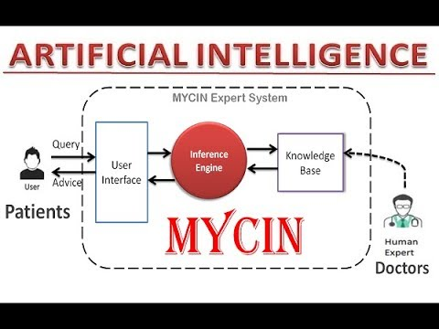
MYCIN Process

Slide 9
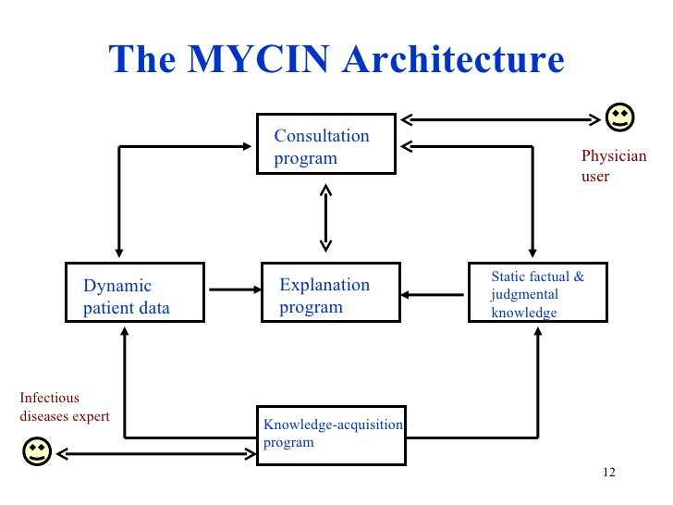

Slide 10
Major Features
Using Backward Chaining
Separate Knowledge from Control
Incorporates Meta-Rules
Inexact Reasoning
Remember Prior Sessions
Accommodates the User

Slide 11
Major Features, Summary
Contain Knowledge
Easy modifiable knowledge
Using backward chaining
Using Meta-rules to control search
Conducts session in English
Perform inexact reasoning
Remember prior session
Explain why a question is being asked
Explain how a result was obtained
Explain why a result was not obtained
Provide alternative solutions if requested

Slide 12
Problem Solving Approach
Diagnosis
    What is the nature of infection?
    What organisms are causing the infection?
Prescription
    What medicines should eliminate the infecting organism?
    What medicines should be safe for the patient?

Slide 13
Problem Solving Approach , Diagnosis
General background information on the patient
Available result from laboratory tests
Direct questioning towards suspected infection
  Intelligent sequence of questions
  A sense of credibility for the program in mind of the physician
Ask physician about his guess about the infection before program identification
  Avoid unnecessary search
  A cooperative style of interaction

Slide 14
Other MYCINs
EMYCIN
  Emycin is an expert system shell, a framework for building programs that record the knowledge of domain experts and use that knowledge to help non-expert users solve problems.
  Empty MYCIN
  Large Amount of LISP Code
TMYCIN
  Tiny EMYCIN
  TMYCIN is an expert system shell modeled after the EMYCIN shell
  Only some features of EMYCIN
PUFF
  Based on EMYCIN
  Has knowledge of lung diseases
NEOMYCIN
  Based on MYCIN
  For teaching, in the laboratories

